Slide 1
Community Resilience
Upper Spokane Watershed
Kootenai County Resilience Meeting
September 18th, 2012
Notes:
Welcome all attendees
Before introductions and agenda, briefly discuss the idea of resilience.
Today we are here to discuss how you and we can improve your community’s resilience to natural hazards. Resilience address how well a community can recover after a disaster strikes. There are many components that contribute to how resilient a community is. These include how well we mitigate a community’s vulnerabilities, how well we prepare for, respond to, and recover from a natural hazard.
What we’re going to discuss today will contribute to improving your community’s resilience. Let’s go through the agenda.

Slide 2
Meeting Agenda
Welcome & Introductions
Meeting Goals
Discovery Map and Report
Flood First Pass Analysis
Risk Report Overview
Earthquake Update
Wildfire Review
Mitigation Planning
Report on Completed Projects
Grant Funding and Updating the Mitigation Plan
Next Steps/Next Scheduled Meeting

Slide 3
Introductions
Name
Title
Community

Slide 4

The Vision for Risk MAP
Through collaboration with State, Local, and Tribal entities, Risk MAP will deliver quality data that increases public awareness and leads to action that reduces risk to life and property
Notes:
In Risk MAP, FEMA’s new NFIP program, MAP stands for Mapping, Assessment (as in "risk assessment"), and Planning (as in “mitigation planning”). Risk MAP is more than just an insurance rate map, it seeks to provide information about risk and support to communities that want to take action to reduce risk.
A big focus in Risk MAP is developing more resilient communities. Let’s talk more about that…

Slide 5
Discussion Questions
What types of tools/materials does your community need to increase risk awareness?
How can FEMA and the State help you?
What capabilities does your community have/need to increase resiliency?
  Administrative and Technical
  Education and Outreach
  Financial
  Planning and Regulatory

Slide 6
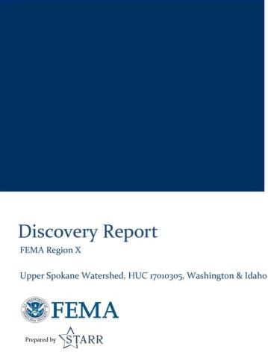
Discovery Process
Meetings were held in May of 2012 with Kootenai County, City of Coeur d’Alene, City of Dalton Gardens, City of Hauser, City of Hayden, City of Hayden Lake, City of Rathdrum, and the City of Post Falls.
Identified hazards, outreach materials, mitigation and risk assessment needs and flood study needs
Engineering specific call with communities to discuss flood mapping issues
Draft report was created summarizing the community needs

Slide 7
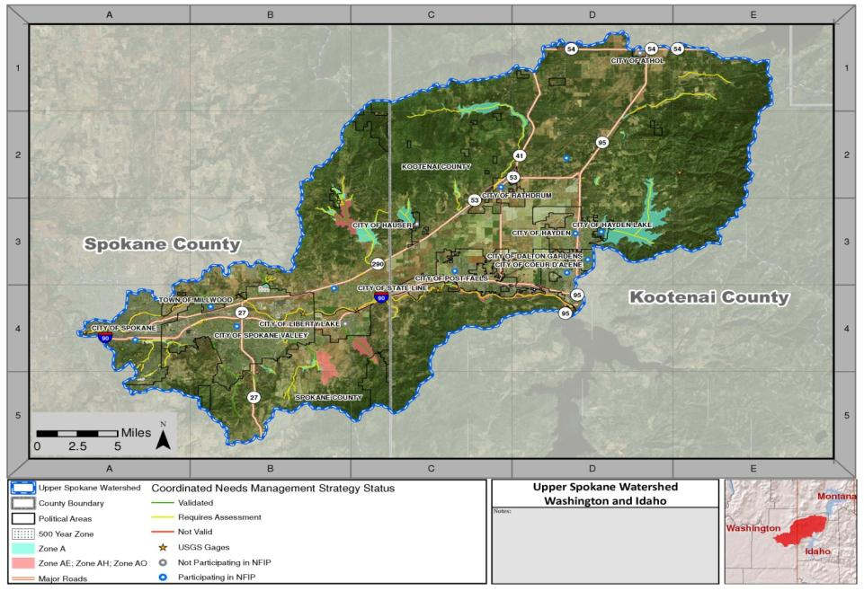

Slide 8
Areas of Concern
Coeur d’Alene
Environmentally Sensitive Areas | The community is concerned with lake and river quality
Fire | Communications infrastructure enhancement measures are desired by the county.
Fire | Maintaining fire mitigation measures is of concern
Flood | There is an area of ponding caused by a drainage issue
Severe Storms | Long term power outages are experienced during severe storms
Dalton Gardens
Environmentally Sensitive Area | Tottens Pond (located in the northeast corner of the city on private land) is an environmentally sensitive area.
Fire | Canfield Mountain is a wildfire risk. One resident lives on the mountain.
Hayden
Environmentally Sensitive Areas | Isolated wetlands exist along the northeast and southeast corner of the city limits.
Flood | Earthen dams are located along the lake at the city boundary
Flood | There is a flood potential from ponding caused by drainage issues in this area
Infrastructure | All sanitary sewers are pumped out of the City of Hayden. Sand bagging efforts around lift stations have been required for protection of these facilities from flooding.
Landslide | Hayden Canyon area in the northeast section of Hayden has significant slopes and is a concern for landslides.
Notes:
The communities provided a list of areas of concern during our meetings last May
The highlighted areas represent some of the areas that FEMA

Slide 9
Areas of Concern
Kootenai County
All-Hazards | Assistance may be requested to update the multi-jurisdictional hazard mitigation plan
Environmentally Sensitive Area | Isolated wetlands exist and are environmentally sensitive areas that need protection
Fire | Communication infrastructure enhancement measures are desired by the county
Fire | Wildfire evacuation routes are of concern within the county.
Flood | An update is requested here to add Base Flood Elevations
Flood | Hazel Creek’s 500-year floodplain revision is requested in this area
Flood | Several LOMAs exist around Hayden Lake. A redelineation of the lake is needed if more detailed topography exists
Flood | There is a nuisance flooding area in the City of Hauser in a farming region. This is an area of repeated flooding but no claims have been submitted since they are not part of the NFIP.
Landslide | There is a potential for landslide risk in this area
Severe Storms | Formal plan for shelter operations is of interest to community leaders
Severe Storms | Resources are exhausted (man power, financial, materials) during widespread disasters. There are no backups or relief plans currently in place.
Severe Storms | Snow volume management plan is needed
Severe Storms | Transportation needs assistance and communications enhancement during disasters is of interest to community leaders.

Slide 10
Areas of Concern
Post Falls
All Hazards | Communications and outreach support during and after disasters are of interest by community officials.
Environmentally Sensitive Areas | Corbin Park and Q’emlin Park
Fire | Moderate to high fire risks exist in open field areas and north of HWY 53 and south of Spokane River. Local officials are interested in outreach and education for homeowners on fire prevention and defensible space.
Flood | Harbor Island Seawall protects the island from flooding
Rathdrum
All Hazards | Outreach materials are requested by community officials
Aquifer | The Willow Creek dike is critical for ground water recharge.
Flood | The Bingham Street culvert size is inadequate according to local officials
Flood | There is a major development occurring in the southern portion of the city. This may be an area that should be mapped in more detail for flooding.
Severe Storms | High winds causing drifting snow are a concern to community leaders. Additional snow volume management planning may be of interest.

Slide 11
First Pass Analysis
Methodology
  Inventory of flooding sources (CNMS database, FIS)
    Mileage of detailed and approximate riverine analyses
    Date of effective analyses
    H&H methods/models used
    Availability of effective analysis data (digital, hard copy)
  Needs assessment
    Critical issues – re-study recommended in high-risk areas
    Secondary issues – re-study may be recommended if certain issues are found
    Availability of high-quality topographic data (LiDAR, 1 or 2-ft contours) – foundation for new RiskMAP studies
Notes:
The First Pass Analysis provides an opportunity to review the models and data from the previous flood studies in the area to see how valid the old data/models are and what may change if a new flood study is conducted.

Slide 12
First Pass Analysis
Kootenai County Summary
  Spokane River
    Studies dated of 1976 (Spokane Co) and 1986 (Kootenai Co);
    Hydrologic analyses, based on stream gage data, differ across state line, resulting in different effective discharges at WA-ID border;
    Hydraulic analyses performed with models no longer supported (NRCS WSP2, USACE HEC-2)
  Other flooding sources:
    No new studies since 1986
    Unit runoff vs. drainage area curves used for Rathdrum Creek & Nettleton Gulch
    No modeling used to map other streams
    New USGS regression equations available since 2002

Slide 13
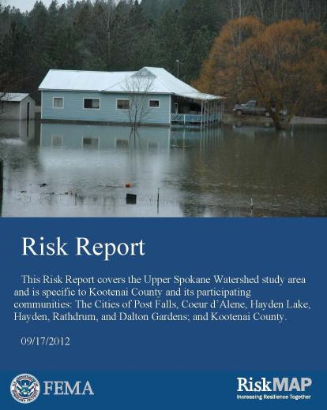
Risk Report
Draft Risk Report focusing on flood, earthquake, wildfire, and severe storm
HAZUS analysis was completed for flood losses
One page pullouts focusing on each disaster for citizens and developers

Slide 14
Risk Report: Flood Results
 |  |  | Estimated Potential Losses for Flood Event Scenarios
 | Total Inventory |  | 10% (10-yr) |  | 2% (50-yr) |  | 1% (100-yr) |  | 0.2% (500-yr)
 | Estimated Value | % of Total | Dollar Losses⁵ | Loss Ratio^{1,6} | Dollar Losses⁵ | Loss Ratio^{1,6} | Dollar Losses⁵ | Loss Ratio^{1,6} | Dollar Losses⁵ | Loss Ratio^{1,6}
Residential Building/Contents | $1,403,900,000 | 3% | $9,500,000 | 1% | $12,000,000 | 1% | $14,200,000 | 1% | $16,800,000 | 1%
Commercial Building/Contents | $1,820,700,000 | 9% | $33,300,000 | 2% | $45,000,000 | 2% | $48,700,000 | 3% | $56,100,000 | 3%
Other Building/Contents | $205,900,000 | 3% | $1,700,000 | 1% | $3,500,000 | 2% | $3,700,000 | 2% | $4,300,000 | 2%
Total Building/Contents | $3,430,500,000 | 4% | $44,600,000 | 1% | $60,500,000 | 2% | $66,700,000 | 2% | $77,100,000 | 2%
Business Disruption³ | N/A | N/A | $10,000 | 0% | $10,000 | 0% | $10,000 | 0% | $10,000 | 0%
TOTAL | $6,861,000,000 | 4% | $51,000,000 | 1% | $69,000,000 | 2% | $75,900,000 | 2% | $87,800,000 | 3%
Note: Loss Ratios are a useful gage to determine overall community resiliency.

Slide 15
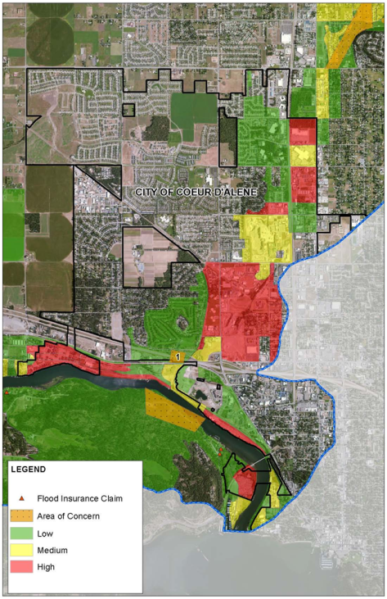
To be included in the final draft:
Critical Facilities
Debris
Shelter/displaced households

Slide 16
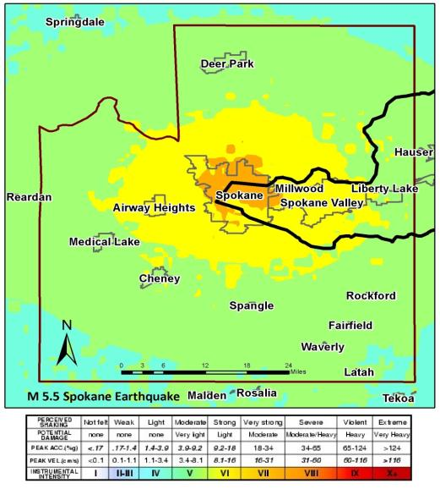
Risk Report: Earthquake Results

Slide 17
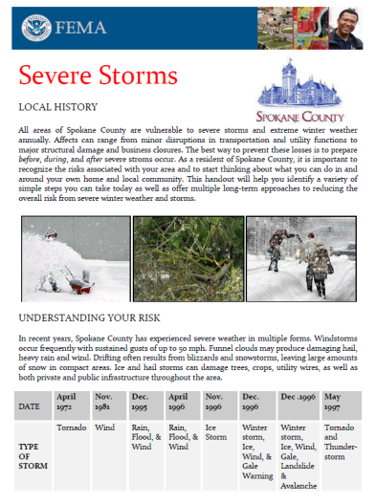
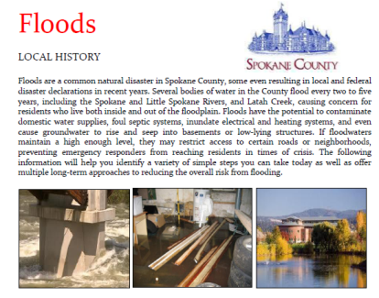
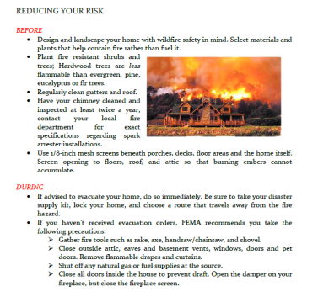
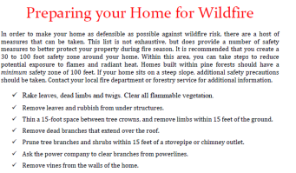
Risk Report: Outreach Inserts
Notes:
City of Spokane requested these products, but they are applicable to all communities in the watershed
Provide input so we can tailor them to your needs.
Word documents will provided in final draft so you can continue to edit and use them.

Slide 18
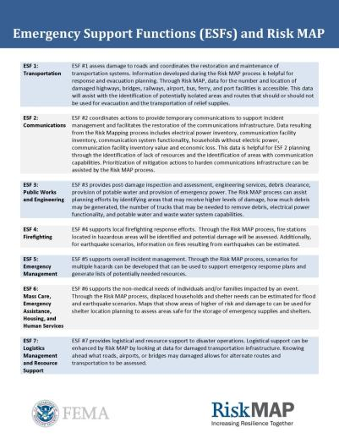
ESFs and Risk MAP Handout
Provides a list of uses of Risk MAP products during Response Planning efforts

Slide 19
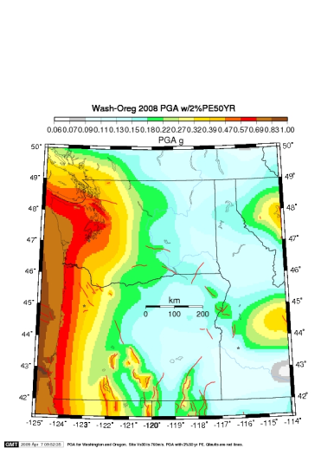
Earthquake Overview
National Earthquake Hazard Reduction Program (NEHRP) – FEMA/USGS/NIST/NSF
In support of the NEHRP Mission - FEMA provides
    Increases local and State knowledge capacity on earthquake mitigation via training and technical assistance
    Equip local communities with tools to support the planning and application of earthquake mitigation strategies
    Support the implementation of approved earthquake mitigation special projects
Low Risk Does Not Mean No Risk
Notes:
Tamra, EQ Program Manager, will talk about the earthquake risk and current studies on their way for this area.

Slide 20
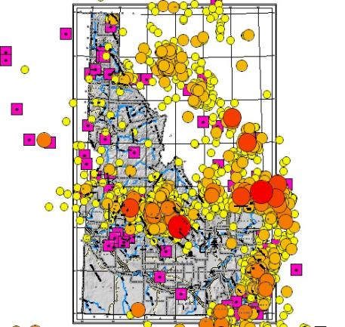
Earthquake Overview
1969-2007- Instrumental Seismicity M>0.0
1872-2000- Instrumental Seismicity M>3.0
Notes:
Regional seismic monitoring in the IMW Region continues to rely on a geographic patchwork of seismic networks, involving both stably-funded and unstably-funded operations. Well-established networks cover most of Utah, Nevada, and Montana. Throughout the IMW Region�and especially in Idaho, Wyoming, New Mexico, Colorado, and Arizona�the challenges are to achieve adequate geographic coverage of seismically hazardous areas, especially in gaps between existing networks and in areas that have been historically neglected; stable network operations in areas where seismic hazard and/or risk warrants continuous seismic monitoring; and coordinated data exchange, uniform earthquake reporting and response, and compilation of homogenous earthquake catalogs for more systematically defined regions of responsibility

Slide 21
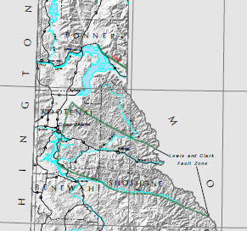
Earthquake Overview
Idaho Geological Survey - Fault Hazard Map

Slide 22
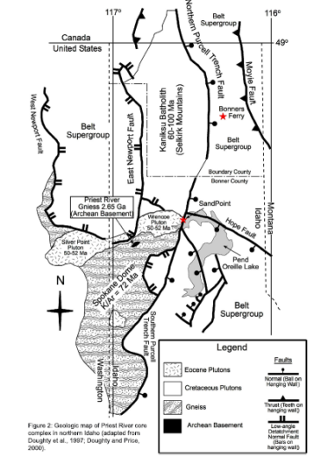
Earthquake Overview
Geological Map of Northern Idaho
Faults Identified
US History short & Seismic Monitoring History shorter
“Low Risk Does Not Mean NO risk”

Slide 23
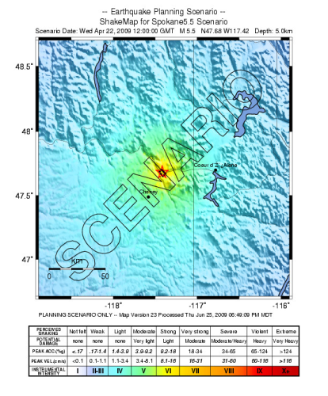
Earthquake Overview
USGS Shakemap
http://earthquake.usgs.gov/earthquakes/shakemap/
Scenario Earthquake-Not the real thing
No ShakeMap doesn’t mean that the threat doesn’t exist.

Slide 24
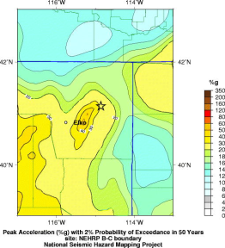
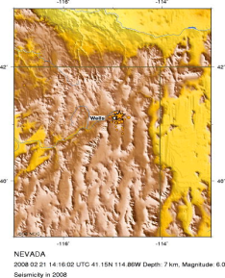
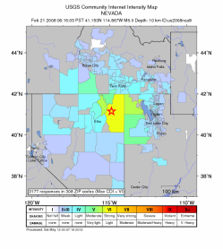
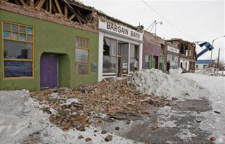
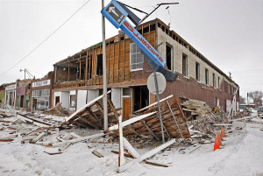
Earthquake Overview
Notes:
Magnitude 6.0 – 4.2 miles depth – Not on a known fault - Feb 2008
5 miles from Wells Nevada
Three people injured, more than 20 buildings heavily damaged, almost 700 buildings slightly damaged and a water main broken at Wells

Slide 25
Earthquake Overview
Training Available from FEMA
  FEMA 154/ATC 20 : Property Inventory & Seismic Safety Inspection
  FEMA 74: Non-Structural Mitigation
  FEMA 596: Seismic Rehabilitation
  FEMA 767: Earthquake Mitigation for Hospitals
  FEMA 395: Earthquake Safety and Mitigation for Schools

Slide 26
Earthquake Overview
  FEMA EMI Online Course, IS-325 - Earthquake Basics: Science, Risk, and Mitigation
  QuakeSmart Toolkit for Businesses,
  Building Code Toolkit for local building officials,
  More to come…
  Resources and Supporting Materials Available at
    http://www.fema.gov/earthquake

Slide 27
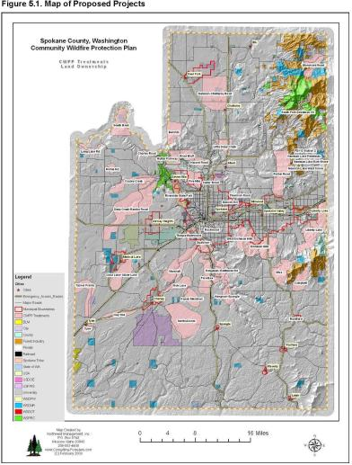
Wildfire Hazard
Community Wildfire Protection Plan
  Completed in 2006
  Prioritized mitigation actions

Slide 28
Wildfire Hazard
Community Wildfire Protection Plan
  Completed in 2006
  Prioritized mitigation actions
Challenges
  Accurate and up-to-date wildfire risk assessment

Slide 29
Wildfire Hazard:
West Wide Wildfire Risk Assessment
Deliverables
  Comprehensive Wildfire Database
  Wildfire Risk Assessment
  Final Report – Methods, Findings, and Using the Assessment Products
Model Outputs
  Wildland Fire Susceptibility Index (Wildfire Threat)
  Level of Concern Index (Wildfire Risk)
ID Contact: Andrew Mock, amock@idl.idaho.gov
Website: http://www.westwideriskassessment.com
Notes:
Andrew will speak to this slide.

Slide 30
Mitigation Planning
Kootenai County Multi-Jurisdiction All Hazard Mitigation Plan
Expires May 27, 2015
  Includes communities of:
Kootenai County Coeur d’Alene Dalton Gardens Harrison Hauser Hayden | Post Falls Rathdrum Spirit Lake Worley Hayden lake
Notes:
Kootenai Co has a current plan that expires in 2015. The work done through Risk MAP will contribute to the information in your plan and the update process.
Mitigation planning is a process for bringing together stakeholders to assess local risk and to develop strategies to address that risk. There are some major benefits to mitigation planning, including that just having a plan allows you to apply for certain grants. Having a plan also means that your community has prioritized risks and solutions.
Mitigation planning needs to be a community-wide effort, not just something put together by one department or hired help. Good mitigation planning requires input from a variety of local officials and possibly other stakeholders, because at it’s best, responsibility for risk reduction is shared by all staff in local government, in all the activities that are considered.

Slide 31
Mitigation Planning Benefits
Identifies cost effective actions for risk reduction that are agreed upon by stakeholders and the public
Focuses resources on the greatest risks and vulnerabilities
Builds partnerships by involving people, organizations, and businesses
Increases education and awareness of hazards and risk
Communicates priorities to state and federal officials
Aligns risk reduction with other community objectives

Slide 32
Challenges to Achieving Mitigation Goals
Loss of interest or meeting fatigue after the end of the mitigation planning and adoption process
Lack of funding and other resources and capabilities
Insufficient political will to address the more complicated problems and controversial solutions
Apathy created by “disaster amnesia” or the perception that “nothing ever happens here
Mitigation strategy is not well connected with day-to-day operations

Slide 33
Actions Successfully Implemented
What actions have you successfully implemented in the past year? What contributed to its success?
Considering the information you heard today, do you have the capabilities to use this data?
    Challenges
    Opportunities
Notes:
Sandy will lead discussion and ask group to discuss any mitigation action successes.
What opportunities do you have to implementing mitigation actions?
What barriers exist to implementing mitigation actions?

Slide 34
Recommendations for Success
Use the Post-Disaster Window of Opportunity
Focus on Quality over Quantity
Develop Strong Messaging
Encourage Local Champions
Identify a Mentor

Slide 35
Update on County Mitigation Plan
Action Item
  Letter of Intent from communities who wants to be included in grant for the mitigation plan update
Notes:
Sandy will lead this section on their plan update.

Slide 36
Next Steps
Final Risk Report
Outreach Materials
Mitigation Planning Technical Assistance
When is the next Committee Meeting?

Slide 37
Contacts
FEMA Region X
Idaho
STARR
Amanda Engstfeld
Risk Analyst
Amanda.Engstfeld@fema.dhs.gov
425-487-4626
Brett Holt
Mitigation Planner
Brett.holt@fema.dhs.gov
425-487-4553
Ted Perkins
Regional Engineer
Dwight.perkins@fema.dhs.gov
425-487-4684
Tamra Biasco
Earthquake Program Manager
Tamra.biasco@fema.dhs.gov
425-487-4645
Karen Wood-McGuiness
NFIP Specialist
Karen.Wood-Mcguiness@fema.dhs.gov
425-487-4645
Ryan McDaniel
RiskMAP Coordinator
Ryan.McDaniel@idwr.idaho.gov
(208) 287-4926
Mary McGown
NFIP Specialist
Mary.McGown@idwr.idaho.gov (208) 287-4928
Mark Stephensen
Hazard Mitigation Officer
mstephensen@bhs.idaho.gov
(208) 422-5726
Susan Cleverley
State Mitigation Planner
scleverl@imd.idaho.gov
208-422-6476
Becca Croft
becca.croft@starr-team.com (425) 329-3699
Josha Crowley
Josha.Crowley@starr-team.com (425) 329-3679

